Slide 1
DevOps
Presented by:
CG Team

Slide 2
Agenda
What is DevOps?
Typical Agile Scenario
Dev vs. Ops war
Current Focus Area
Dev, Ops, QA to DevOps
5 C’s of DevOps
DevOps Maturity Level
Team’s Transition to DevOps
Proposal- Improvement Area
DevOps Benefits and Costs
Sample Pilot Plan
Git Automation
Proposal of Jenkins

Slide 3
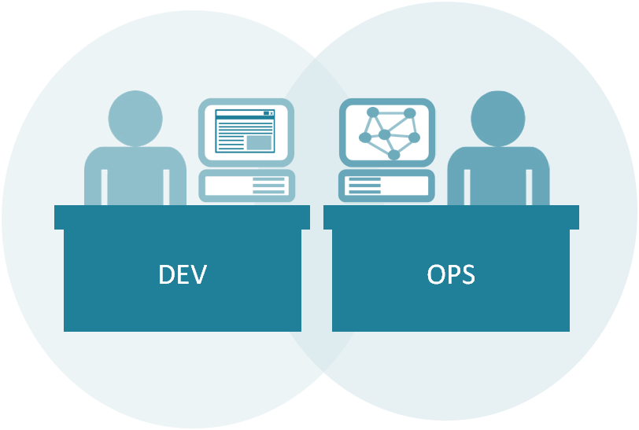
What is DevOps?
DevOps is a collaborative way of developing and deploying software. It is a software development method that stresses communication, collaboration and integration between software developers and information technology (IT) operation professionals

Slide 4
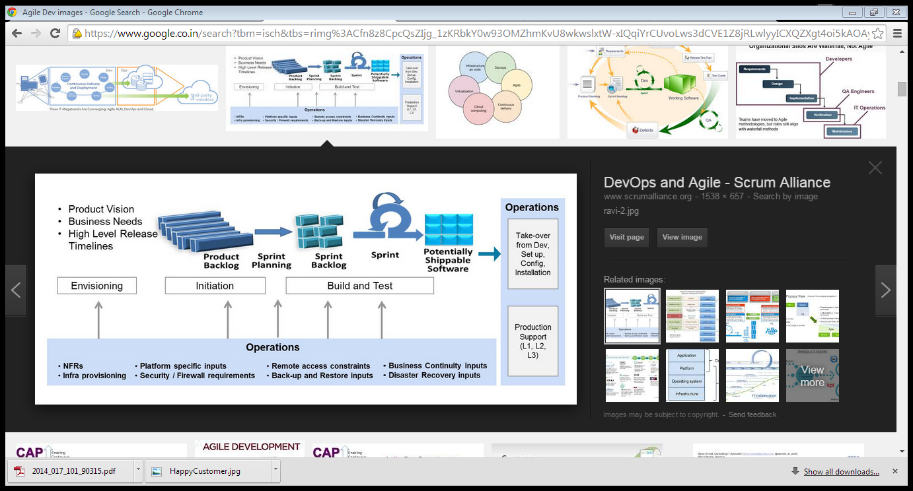

Typical Agile Scenario
Deploy to Production
Friday 5:00 p.m the D day .. The Potentially Shippable Product Shipped to Production
Notes:
Product vision , business needs, and high level Release timelines leads to a Product backlog, during Sprint planning we prioritize the product features
Into the Sprint backlog
A Sprint is executed and a “Potentially Shippable Product” is demoed to the customer. Customer gives a sign off and we are good to go for the next SPRINT.
The point to note here is “Potentially Shippable Product”, why Potentially , because we tested it is a Production like environment , not Production
Friday day 5:00 p.m the D- day after a couple of Sprints we deploy the “Potentially Shippable Product “ to production.

Slide 5

Dev and Ops on the Wrong Tracks
Dev is focused on faster innovation and doing new things.
The mandate to Ops is about stability, control, and predictability.
Dev and Ops will often struggle to talk to each other, much less collaborate, and will remain mired in manual processes. The result is employees who don’t work well together, software that doesn’t work reliably.

Slide 6
Dev Vs Ops War
“It works on my machine”
There is an issue with the build server the code is not building
You must be having the wrong version of the code
It is not the server, it is your code
“We missed an important production dynamics”
5 days in to Operations.. The code finally builds
10 days into Operations.. Why is Debugging enabled?
Cloud of Confusion
“Oh we forgot to inform about a patch installation.. Never thought there would be an impact”
Notes:
And something is quite not right.. The code does not build..The WAR begins.. The war of Dev Vs Ops..
This is the cloud of Confusion..
Well Don’t panic.. We can solve this.. Get Dev and Ops to talk to each other ASAP… that is precisely what DevOps is ??

Slide 7

Get Ops Involved Early
Agile is built around iterative process but idea is to roll out frequent incremental changes rather than save the changes up for a big splash.
Another potential source of trouble is completing steps serially, teams have to work in parallel.

Slide 8

Business Case – Current Focus Area
Release Management Group
Stability
Reliability
Durability
Timely completion
Provide Stable non-production environment
Maintain reliable code repository (GITHub) removing code conflict between GITHub version and Production version
Robust deployment process documentation and checklist which will be followed stringently
Timely refresh of non-production environments

Slide 9
Dev , QA, Ops to DevOps
Quality Assurance
Technology Operations
Development
DevOps

Slide 10


5C’s of DevOps
Plan
Build
Test
Deploy
Monitor
Continuous Feedback
Continuous Integration
Nothing is particularly hard if “YOU DIVIDE INTO SMALL PARTS”
Continuous Testing
Continuous Deployment
Continuous Monitoring

Slide 11
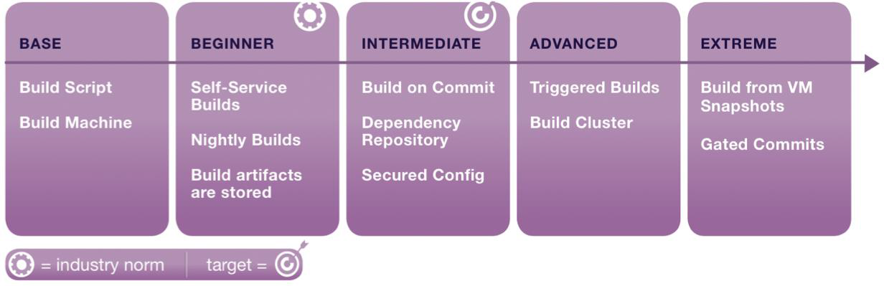
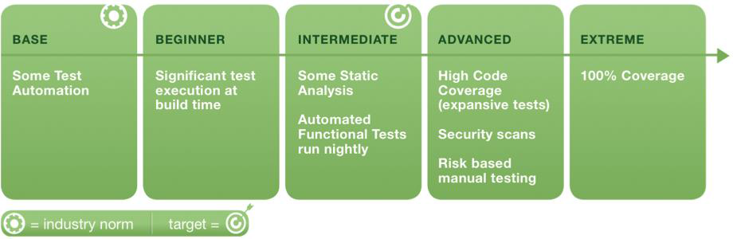
DevOps Maturity Level

Slide 12
Team’s Transition to “DevOps”
DevOps is a journey of discovery not a destination
Dev
Dev
DevOps
Ops
Ops
Overall Effectiveness
Team | Separate Silos | An Ops Rep assigned to 1 or many teams | One Team - Ops member is part of the team
Suitability | Maturing agile teams | An organization with strong tech leadership | Org. with a single main web-based product or service
Risk | Allegations | Shared | Ownership
Alignment to Business Goals | SLA driven | Partial Aligned | Fully Aligned
Responsiveness | Low | Medium | High
Resource Utilization | High | Medium | Low
Delivery Org Change | Low | Medium | High
Age of Issue Identification & Resolution Time | Longer | Medium | Low

Slide 13



Proposal – Improvement Area
Night support from offshore. Few team member will be available during IST night shift
Retention of knowledge related to Github, Auto-build activities
Role rotation within Team
Robust knowledge repository for build deployments
Auto-deployment in all environments with nightly scheduled builds
Stringent checks and cross verification for critical activities
Reduction in cost and efforts due to automation of activities like auto-builds and auto-deployment
Improvement in quality of deliverables by eliminating production issues due to wrong version of deliverables
Reduction in slippage in Release schedule
Benefits

Slide 14
DevOps Benefits / Cost
Benefits
Cost
Automation at Core
Fast time to Production
Quality - Reduced defects because of automation.
Robust system
Stability
Streamlined Process
Better Reporting
Initial one time investment on Automation
Investment on tools
Ongoing maintenance cost for any change which result in change in test case, environment variables
Initial learning curve for team

Slide 15
Sample Pilot Plan
Automated Regression
Tests
Interviews
Implement
Source
Control
Continuous
Integration
Automated
Deployments
Product
Monitoring
Design
Build
DevOps Improvement Pilots
2 Weeks
2 Weeks
2017

Slide 16
GIT Automated Test Scripts
Git-test is a command-line script for running automated tests against commits in a Git repository. It is especially targeted at developers who like their tests to pass on every commit in a branch, not just the branch tip.
Git test will test the commits in that range, reporting any failures. The pass/fail results of running tests are also recorded permanently in your repository as Git "notes“.
If a commit in the range has already been tested, then by default git test reports the old results rather than testing it again. This means that you can run the above command over and over as you work, and git test won't repeat tests whose results it already knows.

Slide 17

How will Jenkins typically fit into our strategy
Checks in code to Repo
Developer
Source Control
(GIT/TFS)
Works on
his machine
Report Back
Grabs latest code
Post Build Steps
Builds
Build Artifacts
(Website)
Run Tests (NUnit,
MS Tests, Cradle, StyleCop,JSHint)
Publish Output to
Live Server
Deploy

Slide 18
Implementation Benefits
Shorter Development cycle
Improved Defect Detection
Reduced Deployment Failures and Rollbacks
Reduced Time to Recover upon Failure
Increased Release Velocity
Improved ROI = Enhanced Customer Satisfaction
Do You Know
We have analyzed and found that there could be a reduction of 20% of incidents and tickets post deployment to production even if we implemented partial DevOps
Notes:
We achieved..
Shorter Development cycle, increased Release velocity due to strong Covergence of Process. Collaborations amongst teams and automation
Defects are detected much ahead on the lifecycle.. Shift left model
Reduced Deployment failures, rollbacks and reduced time to recover.. As we share a common goal and we all work together towards it.
Resulting in Improved ROI = Enhanced Customer Satusfaction = nX Business value

Slide 19
Thank you !!!

